Slide 1
DOPPLER WEATHER RADAR PRODUCTS Rohit Shukla Scientist D(Radar Lab)

Slide 2
Data collection
1 .Azimuth Scan (PPI mode)
2 .Elevation Scan (RHI Mode)
3. Volume Scan (PPI for 10 different angles)

Slide 3
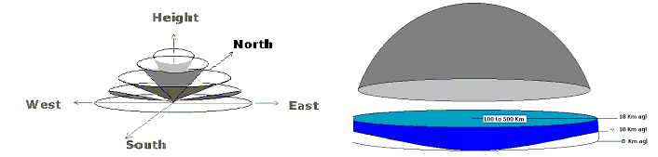
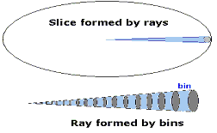

Slide 4
Base Products of DWR
Base Reflectivity (Z)
Radial Velocity (v)
Spectral Width (w)

Slide 5
Base Products of DWR
Reflectivity (Z): Calculated from the reflected power measured by the Radar
Radial Velocity (v): Calculated from change in frequency measured by the radar
Spectral Width (w): Calculated from the velocity distribution in the sampling volume. In fact, variance of the velocity distribution is the spectral width. It’s a measure of turbulence in the clouds.

Slide 6
Base Reflectivity (Z)
Base reflectivity is a radar product that displays the amount of power returned to the radar after it has reflected off particles in the atmosphere.
The actual amount of energy returned is not displayed. What is displayed is a term called reflectivity (hence why this product is named base reflectivity), and is measured in decibels (dBZ).

Slide 7
Base Reflectivity (Z)
Base Reflectivity values can be negative since the reflectivity scale is actually a logarithmic scale, which means the numbers on the scale are actually powers of 10.
The value of reflectivity in a bin of data is actually the average of all the reflectivity values detected within that bin.

Slide 8
Radial Velocity (v)
Radial velocity is a radar product that displays the average wind speed (and in some sense, the direction, hence velocity) of particles that are detected by the radar.
The radar can measure the speed due to a phenomenon called the Doppler Effect, in which the frequency of a wave changes as it bounces off a particle that is moving with respect a stationary object .

Slide 9
Radial Velocity (v)
Looking at a display of base velocity, you are looking at the wind speed either directly towards or directly away from the radar.
Positive values of velocity mean that there is a positive correlation between distance and direction. This means the wind direction is away from the radar when values are positive and vice versa.

Slide 10
Spectral Width (w)
Spectrum Width is calculated from the velocity distribution in the sampling volume. In fact, variance of the velocity distribution is the spectral width. It’s a measure of turbulence in the clouds.

Slide 11
Amplitude Scope" or "A-scope
A-scope" refers to an "amplitude scope" or "A-scope," which is a display method used to visualize radar signals.
The A-scope presents a one-dimensional representation of the radar returns, typically plotting signal amplitude (or strength) against time or distance.

Slide 12
Cont..
This allows operators to see the strength of radar echoes from targets over time, helping to identify their distance and size based on the amplitude of the returns.
It’s a useful tool in radar systems for interpreting data and making real-time decisions based on the detected signals.

Slide 13
DWR Products

Slide 14
Plan Position Indicator ( Z)
This product is obtained at a certain elevation by azimuth scanning of the antenna for 500 km range and shows all echoes received in the radar range.
The intensity of the echoes is expressed in dbZ scale.

Slide 15
Plan Position Indicator ( Z)
The PPI product shows the distribution of the selected data parameter on a constant elevation angle surface — the classic radar display
The product is useful in weather surveillance of all kinds of severe weather activities.

Slide 16
Plan Position Indicator ( Z)
Depending upon the range of the target and the angle of elevation the height of the echo is estimated.
The nearby echoes correspond to lower heights where as the farther echoes correspond to higher altitude depending upon the range and angle of elevation.
The height of the radar beam increases with the range due to curvature of the earth.

Slide 17
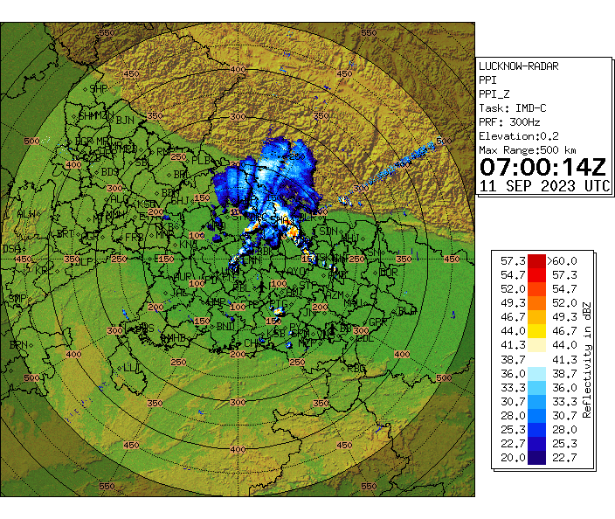

Slide 18
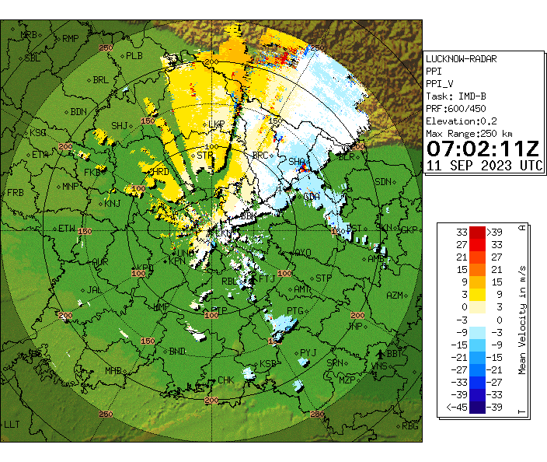

Slide 19
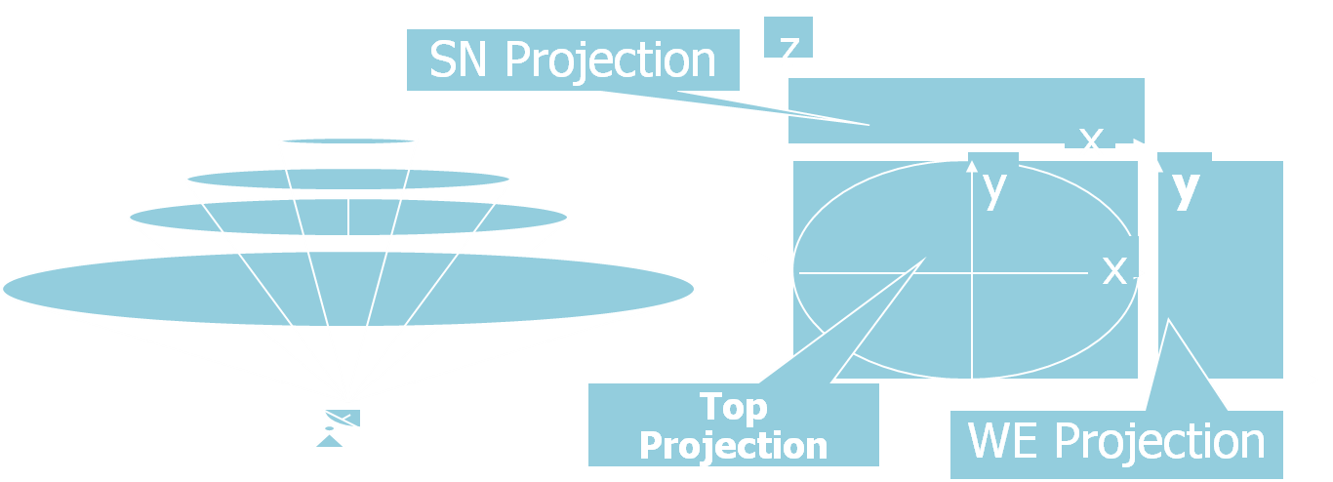
Max - Maximum display (MAX)
Maximum product displays three partial images

Slide 20
(1) Top Projection
A top view as the highest measured values in Z-direction. This image shows the highest measured value for each vertical column, seen from the top of the Cartesian volume.
y
x

Slide 21
(2) W-E Projection
A E-W view of the highest measured values in X-direction. This image is appended to the right of the top view and shows the highest measured value for each horizontal line scan from east to west.
y
z
y
z

Slide 22
(3) SN Projection
N-S view of highest measured values in Y-direction. This image is appended above top view and show highest measured value for each horizontal line scan from north to south.
z
x

Slide 23
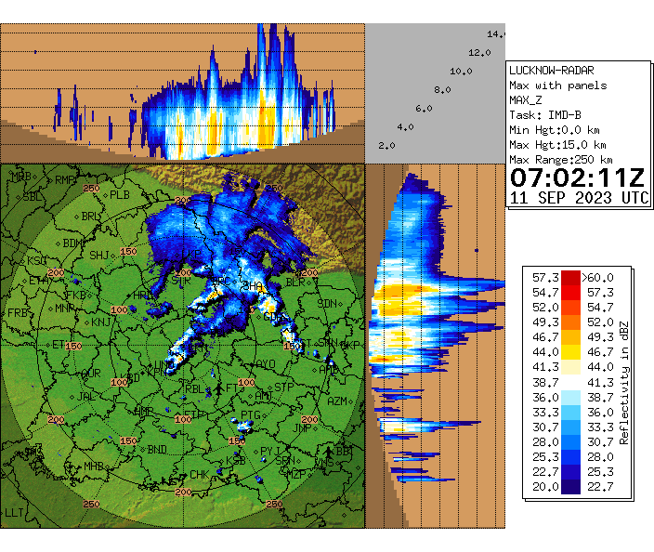

Slide 24
Constant Altitude PPI (CAPPI)
This is a colour coded display for an user defined altitude surface of any of the Z, V and W in a PPI scope.

Slide 25
Constant Altitude PPI (CAPPI)
This product displays echoes at user defined altitude (above mean sea level).
The range of this product extends up to 500 km and height varies from 1 km to 18 km. However, no data places are left blank in the image as shown in figure on next slide.

Slide 26
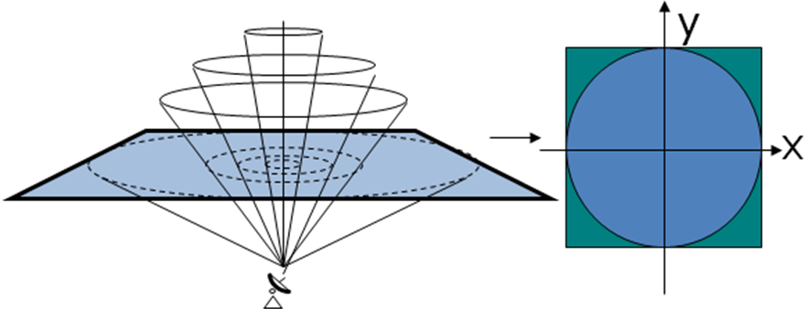
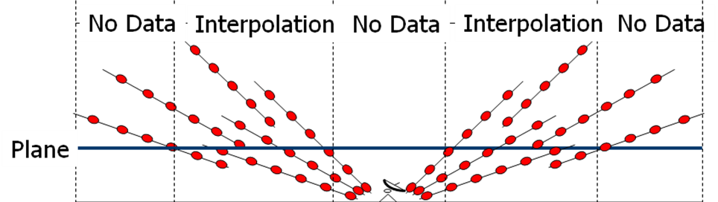
Constant Altitude PPI (Reflectivity)

Slide 27
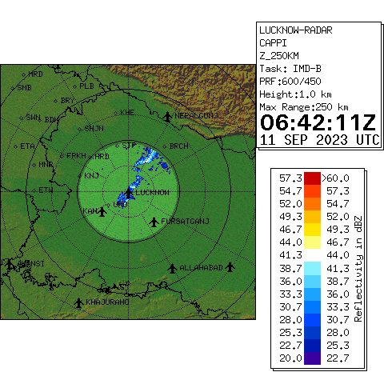

Slide 28
Volume Velocity Processing 2 (VVP2)
This product displays wind velocity profile over the radar station. Wind velocities (speed direction are calculated at different vertical layers and are displayed in the form wind barbs.

Slide 29
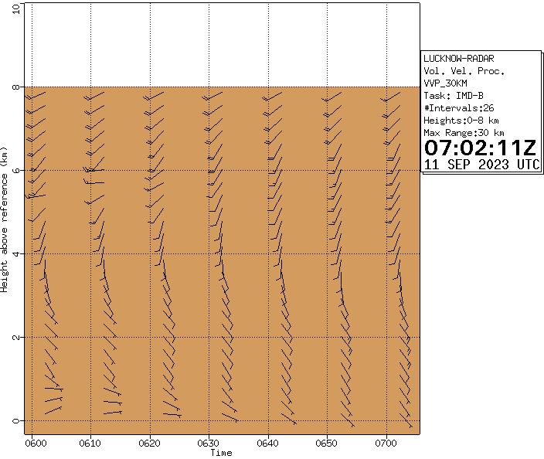

Slide 30
Echo-base product
The echo base product is used to detect the base of echoes in terms of height in Kms for user selectable range of reflectivity.

Slide 31
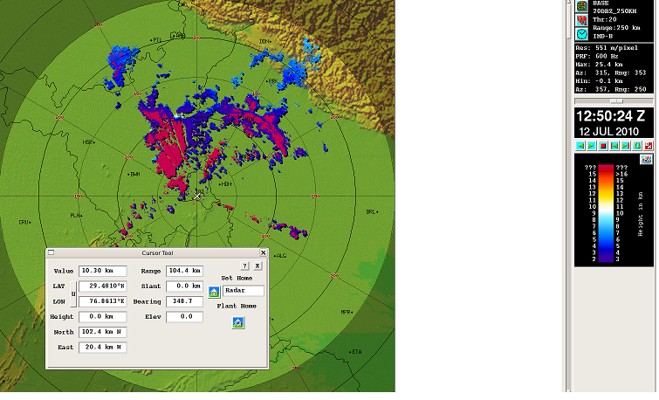

Slide 32
Echo-top product:
Tops product is similar to the base
product. It gives the height of the top of
the cloud in kms for the threshold
value defined by user

Slide 33
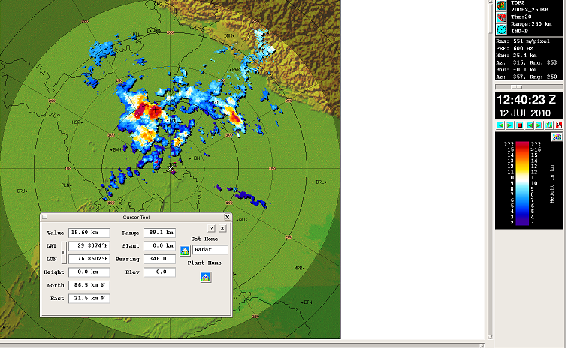

Slide 34
Thick product
Thick product is used to determine the thickness of the cloud in between the threshold value defined by the user e.g. If thr=>20dbz then thickness of the cloud will be given in kms for the values where the dbz=>20 (thickness=top-base in kms)

Slide 35
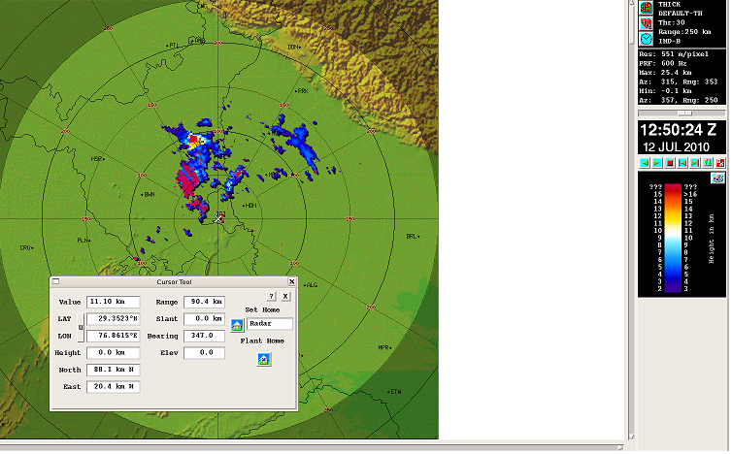

Slide 36
Wind Product:
The wind barbs for the user selectable height and range
It shows wind speed and direction for user defined height

Slide 37
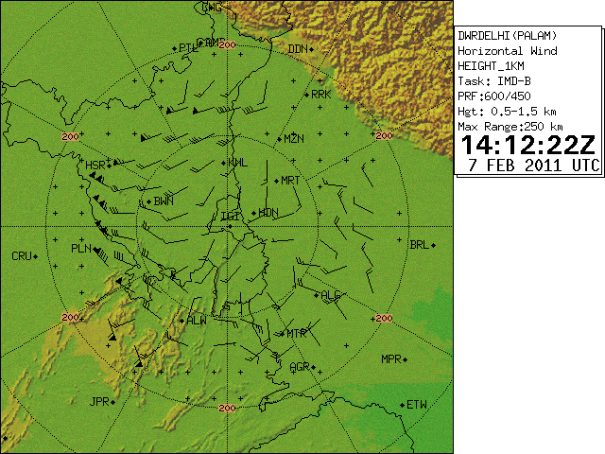

Slide 38
Surface Rainfall Intensity (SRI)
It is an image of the rainfall intensity (in mm/hr) in a user selectable surface layer. It is calculated based on Marshall-Palmer equation
Z=AR^{b}
where R is the rainfall intensity and A and b are constant. The value of A & b varies from season to season and place to place.
sRI is mainly used as an input product to generate rain1 (hourly rain accumulation) product.

Slide 39
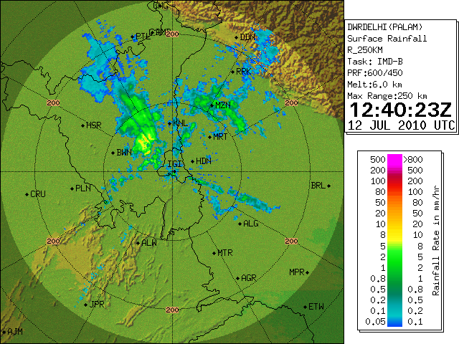

Slide 40
Hourly accumulation product
(RAIN-1)
Input for this product is SRI or CAPPI for user selectable height and range. It gives hourly accumulation of rain in mm.

Slide 41
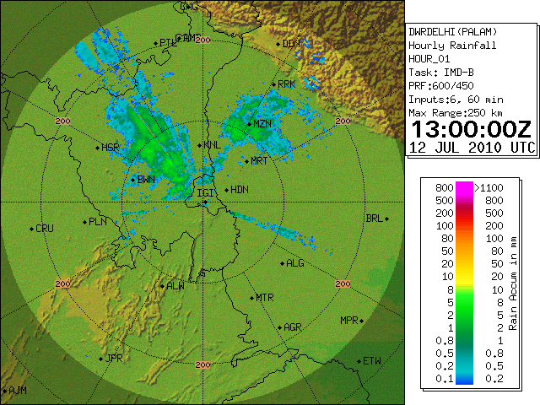

Slide 42
RAINN product
(Rain accumulation for ‘N’ hours)
Input to this product is RAIN1 product. It displays rain accumulation for ‘N’ hours e.g. for 24 hours rain accumulation it sums up the rain1 accumulation for last 24hours
(e.g. 0300utc to 0300utc(next day)

Slide 43
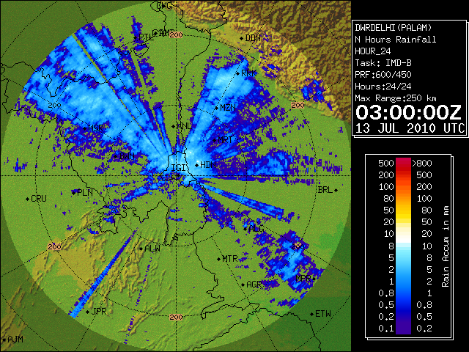

Slide 44
Vertical Integrated Liquid (VIL)
The VIL display gives an instantaneous estimate of water content in an user defined atmospheric layer.. Reflectivity data from volume scan is extracted and converted into liquid water content data. For each vertical column the liquid water content is integrated within user defined boundaries of the atmosphere and the resultant is displayed in a PPI type image. The Water Liquid Content is calculated using the formula:
Z = C * MD
Where Z – reflectivity [mm6/m3]
M – LWC [g/m3]
C and D are constants

Slide 45
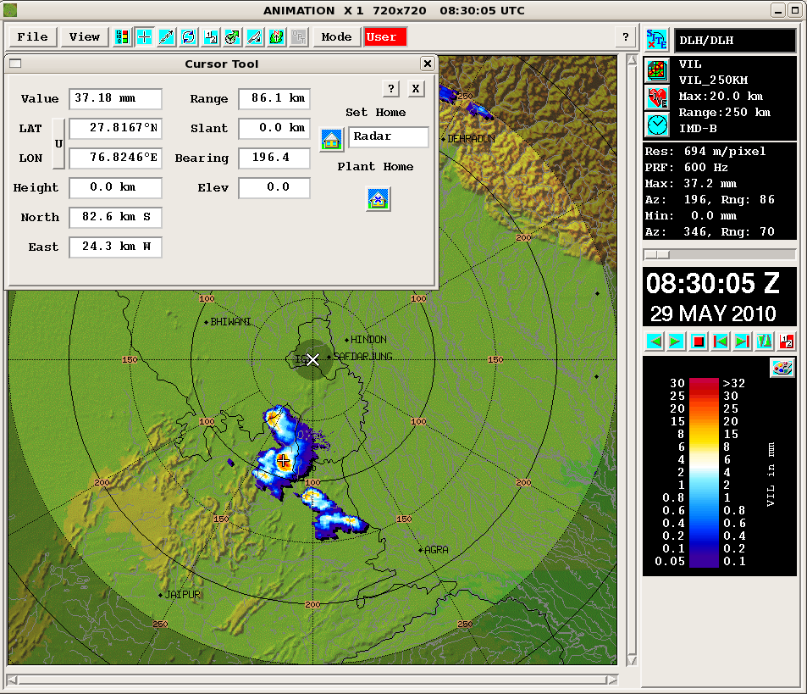
VIL (vertical integrated liquid )
product

Slide 46
Thanks

